Slide 1

Crisis Leadership Overview
Stability, Direction, and Human-Centered Decision-Making Under Pressure
What Is Crisis Leadership?
Leadership during disruption is different from leadership in stability
Crisis compresses time and raises emotional intensity
Decisions must balance authority and empathy
The leader becomes the stabilizing reference point
Notes:
Clarifies leadership’s role when stability collapses Prepares leaders for pressure-driven decisions Explains how presence impacts group psychology Frames authority as a stabilizing function Sets foundation for advanced crisis behaviors
Example: Manager stays calm during a sudden facility shutdown. Cyber example: CISO provides direction during a spreading breach.

Slide 2
CLASS AGENDA
CLASS OBJECTIVES
Define crisis leadership
Shifts from normal leadership
Authority vs calm presence
Decision clarity under pressure
Foundation for advanced topics
Understand the unique context of crisis leadership
Recognize emotional and operational pressures
Learn why clarity matters more than complexity
Link leadership to trust
Set baseline for psychology

Slide 3

How Crisis Changes the Role of a Leader
Leadership shifts from optimizations to stabilization
People look for certainty more than detail
The leader becomes a signal of safety
Clarity beats technical accuracy early in a crisis
Notes:
Optimization stops, stabilization becomes priority Teams seek certainty, not information volume Leader’s tone signals relative safety Early clarity reduces panic escalation Presence outweighs technical expertise initially
Example: Staff watch manager’s demeanor during sudden disruption. Cyber example: Team relies on CISO’s posture over details.

Slide 4

Authority and Decision Rights
Crisis requires shorter decision cycles
Delays create risk and instability
Escalation must be fast and controlled
Decision rights must be understood before activation
Notes:
Decisions must accelerate under pressure Slow choices increase system instability Clear escalation paths prevent hesitation Authority boundaries remove decision confusion Predefined rights speed activation steps
Example: Leader quickly approves backup plan activation. Cyber example: CISO authorizes isolation of core systems.

Slide 5

Emotional Regulation as Leadership Output
People copy the leader's emotional tone
Calm is interpreted as control
Panic is interpreted as incompetence
Regulation precedes clarity
Notes:
Leader’s tone shapes team’s emotional state Calm communicates perceived control immediately Panic erodes trust within seconds Emotional regulation improves decision quality Stability precedes operational clarity reliably
Example: Manager keeps neutral tone during tense meeting. Cyber example: Security lead stays composed during breach call.

Slide 6
Where Leadership Commonly Breaks Down
Delay in declaring the situation
Emotional volatility
Indecisive posture
Conflicting direction
Mixed signals to stakeholders
Inconsistent visibility
Over-focus on technical detail
Unclear roles or authority
Avoidance of responsibility
Fear of accountability
Notes:
Hesitation creates perceived instability Mixed messages confuse entire organization Over-detail distracts from needed direction Emotional volatility accelerates team anxiety Unclear authority disrupts coordinated action
Example: Team freezes when leader contradicts self. Cyber example: Security delays escalate when guidance shifts.

Slide 7

Crisis Leadership as a Stabilizing Function
Leadership reduces uncertainty
Stability generates followership
Communicated calm lowers panic
Confidence enables execution
Notes:
Stability reduces organizational fear immediately Calm leadership lowers team reactivity Predictability builds rapid followership Consistency supports coordinated actions Confidence spreads through visible composure
Example: Staff relax when leader speaks steadily. Cyber example: SOC steadies after CISO’s calm briefing.

Slide 8
What People Need From a Crisis Leader
Clarity
Confidence
Direction
Defined next steps
Emotional safety
Protection from noise
Visible presence
Trustworthy tone
Consistency
Predictable messaging
Notes:
Clear direction to reduce uncertainty Emotional safety during heightened stress Visible presence when confidence drops Consistent tone to prevent confusion Simple next steps to regain control
Example: Leader outlines immediate tasks calmly. Cyber example: CISO defines clear containment steps.

Slide 9
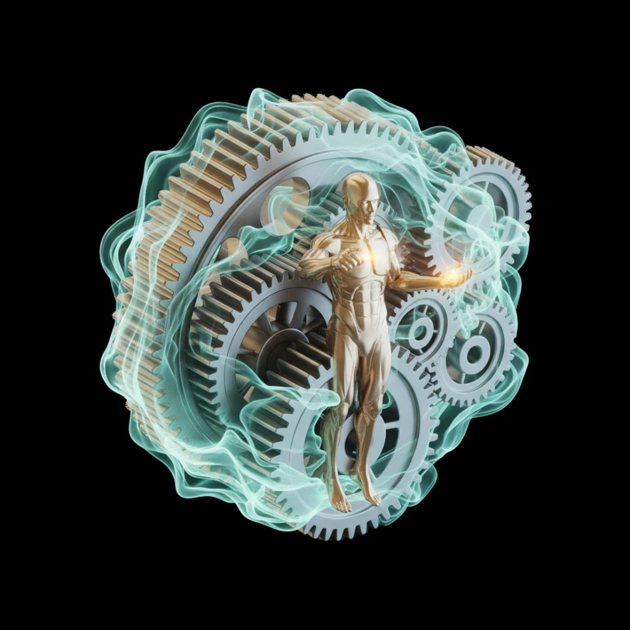
The Hybrid Model of Crisis Leadership
Combines authority with calm presence
Uses structure without rigidity
Guides rather than reacts
Provides confidence before solutions
Notes:
Authority balanced with steady presence Structure used without excessive rigidity Guidance prioritizes clarity over speed Confidence offered before providing solutions Tone drives perception of competence
Example: Leader sets rules while remaining empathetic. Cyber example: CISO enforces controls calmly during breach.

Slide 10

Crisis Leadership Posture
Upright visibility
Stable tone
Controlled pacing
Calm delivery
Short instructions
Decisive close-out
Simple framing
No panic cues
Low emotion language
Reassuring cadence
Notes:
Visible stance signals organizational stability Short instructions reduce cognitive load Simple framing calms overwhelmed teams Neutral language avoids panic cues Steady pacing regulates group reactions
Example: Manager speaks slowly during tense updates. Cyber example: Security lead avoids urgent tone unnecessarily.

Slide 11

Summary & Takeaways
Crisis leadership is a distinct discipline
People follow emotional signals before direction
Stability is the first output of leadership
Clarity reduces fear and hesitation
Authority without calm loses trust
Calm without direction loses control
True crisis leadership is hybrid: structure + presence
Notes:
Crisis leadership requires specialized posture Emotion guides behavior before logic Stability becomes leadership’s first deliverable Clarity reduces immediate uncertainty Effective leadership blends presence and structure
Example: Staff settle after leader sets tone. Cyber example: Breach response stabilizes after firm guidance.

Slide 12
BREAK TIME
Be back in 15 mins.
Notes:
https://www.ncsc.gov.uk/static-assets/documents/PwnedPasswordsTop100k.txt

Slide 13

Psychology of Crisis
Stress, uncertainty, and time compression
How the mind reacts under pressure and what leaders must stabilize first.
What happens in our minds during a Crisis
How the Psychological Response is directly related to resilience
How decision making is affected
Leaderships role during the Crisis
Your role during the Crisis
The impact of cognitive biases on decision-making under pressure
The role of emotional regulation in maintaining composure
Importance of fostering psychological safety in teams during crisis

Slide 14
CLASS AGENDA
CLASS OBJECTIVES
How crisis affects the human mind
Stress and physiological response
Uncertainty and psychological distortion
Time compression and decision impact
Implications for crisis leadership
Understand why reactions intensify under crisis
Recognize what leaders must stabilize first
See how cognition changes under pressure
Link psychology to behavior and performance
Prepare for leadership countermeasures

Slide 15

What "Crisis Psychology" Means
Crisis shifts people from reasoning to survival mode
The brain looks for safety signals before information
Emotion becomes the first filter for perception
Leaders must stabilize minds before processes
Physiological responses like 'fight, flight, or freeze' are amplified, prioritizing immediate threat response over complex thought.
Cognitive biases increase, leading to distorted perceptions and difficulty evaluating risks rationally.
Clear, concise communication and visible, calm leadership are crucial for re-establishing a sense of safety and control.
Notes:
Threat triggers survival-focused thinking Emotion filters messages before logic Body prioritizes protection over analysis Leader must restore psychological grounding Calm reopens rational thought pathways
Example: Employee freezes when overwhelmed suddenly. Cyber example: Analyst misreads signals during breach stress.

Slide 16
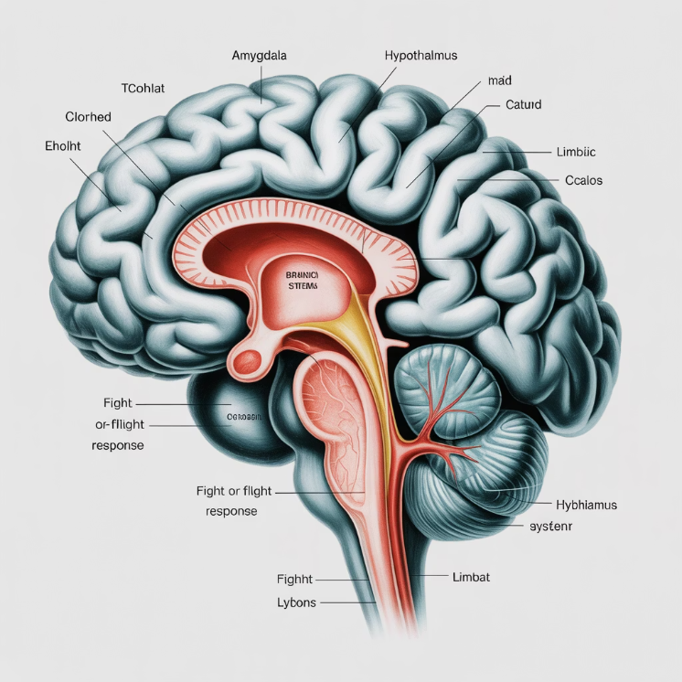
Threat Response: The Primitive Brain First
Under threat, the brain prioritizes survival over logic
Fight–flight–freeze emerges before analysis
Emotional systems override executive thinking
The prefrontal cortex, responsible for planning and logic, is suppressed.
This ancient response is an evolutionary safeguard for rapid action against danger.
Re-establishing a sense of control helps reactivate rational thought processes.
Calm must be reintroduced before clarity
Notes:
Survival instincts override reasoning quickly Fight-flight-freeze activates under threat Logic becomes secondary temporarily Control signals calm primitive responses Presence restores higher thinking ability
Example: Worker reacts impulsively to loud alarm. Cyber example: Analyst misjudges alert severity under panic.

Slide 17

Physiological Stress Reactions
Adrenaline compresses reaction speed
Breathing becomes shallow and unstable
Cognitive range narrows
Discomfort is misread as danger
Increased muscle tension impairs fine motor control
Peripheral vision diminishes, leading to "tunnel vision"
Digestion slows as blood is redirected, leading to physical discomfort
Notes:
Stress accelerates physical responses Breathing becomes shallow when threatened Cognitive range narrows significantly Body misreads discomfort as danger Stress impairs fine-motor capability
Example: Employee feels shaky during sudden crisis. Cyber example: Analyst mistypes commands under pressure.

Slide 18
Stress Effects - Physical
Hyper-vigilance
Overreaction
Tunnel vision
Emotional spikes
Stress Effects - Behavioral
Reduced patience
Defensive posture
Short attention span
Escalated tone
Physical tension
Lowered reasoning range
Notes:
Heightened vigilance reduces mental flexibility Emotional spikes disrupt communication Tunnel vision narrows situational awareness Behavior becomes defensive quickly Reasoning capacity drops under strain
Example: Worker snaps at peers unintentionally. Cyber example: Analyst escalates unnecessarily due to tension.

Slide 19
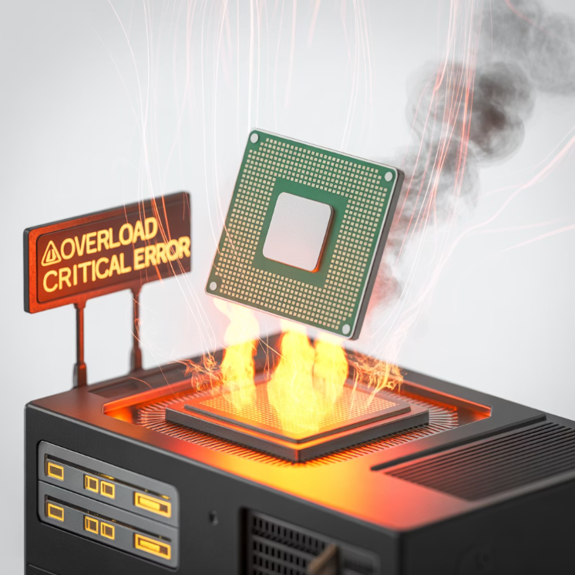
Cognitive Overload Under Crisis
The brain drops nonessential thinking
Processing speed declines
People revert to habit, not planning
Complexity becomes overwhelming
Decision-making becomes less rational
Situational awareness decreases significantly
Emotional responses amplify, impacting judgment
Notes:
Brain suppresses nonessential thinking Processing speed declines rapidly People revert to habitual actions Complex tasks become overwhelming Judgment becomes less consistent
Example: Employee forgets simple steps under stress. Cyber example: Engineer defaults to old procedures.

Slide 20

What Uncertainty Does to the Brain
Uncertainty removes psychological footing
People search for control signals
Doubt feels like danger
Silence increases perceived threat
It triggers a heightened state of vigilance and anxiety
Cognitive resources are diverted to monitoring threats, reducing capacity for complex tasks
The need for closure increases, sometimes leading to premature decisions
Notes:
Uncertainty erodes psychological grounding People scan environment for control Silence increases fear response Threat perception becomes exaggerated Closure-seeking accelerates poor decisions
Example: Staff panic with unclear instructions. Cyber example: Team assumes breach worse than reported.

Slide 21

Perceptual Distortion
Threats feel larger than they are
People assume worst-case outcomes
Neutral cues feel unsafe
Risk becomes exaggerated
Cognitive biases amplify negative interpretations
Emotional states influence how information is processed
Focus narrows to potential dangers, ignoring positive aspects
Notes:
Threats feel amplified emotionally Neutral cues interpreted negatively Worst-case thinking dominates perception Biases distort understanding quickly Focus narrows to potential harm
Example: Employee overreacts to minor change. Cyber example: Analyst misreads harmless log entries.

Slide 22
Uncertainty Effects - Mental
Mental fog
Rumination
Hesitation
Distrust
Anxiety loops
Uncertainty Effects - Social
Story-making
Worst-case bias
Emotional projection
Compromised judgment
Social withdrawal
Notes:
Mental fog reduces reasoning capacity Rumination amplifies perceived danger Distrust increases under silence Story-making replaces facts quickly Judgment weakens under social anxiety
Example: Team speculates when uninformed. Cyber example: Staff assume systems compromised broadly.

Slide 23

Time Compression Defined
Time "feels shorter" than it is
Urgency accelerates emotional impact
Action feels mandatory even without clarity
Delay feels like failure
Heightened stress response: The constant feeling of urgency triggers a sustained fight-or-flight response.
Narrowed focus: Prioritizing immediate tasks can lead to overlooking long-term strategy or important details.
Impaired decision-making: Rushed choices are common as the mind seeks quick resolutions, often at the expense of thorough analysis.
Notes:
Time feels shorter under stress Urgency accelerates emotional reactions Delays feel like immediate failures Focus shifts to immediacy only Rushed decisions become more common
Example: Leader feels rushed despite time available. Cyber example: Analyst pushes quick fix without review.

Slide 24

Decision Pressure Under Time Compression
Leaders feel forced to act instantly
Mental shortcuts replace reasoning
Strategic thinking collapses into reaction
Fatigue accelerates poor judgment
Pressure impairs information processing and risk assessment
Confirmation bias strengthens, seeking quick validation for rapid choices
Focus shifts to immediate fixes, overlooking long-term consequences
Notes:
Instant decisions feel mandatory Mental shortcuts replace analysis Fatigue worsens judgment quality Bias increases under urgency Long-term impacts become overlooked
Example: Manager approves action too quickly. Cyber example: Engineer deploys patch without testing.

Slide 25
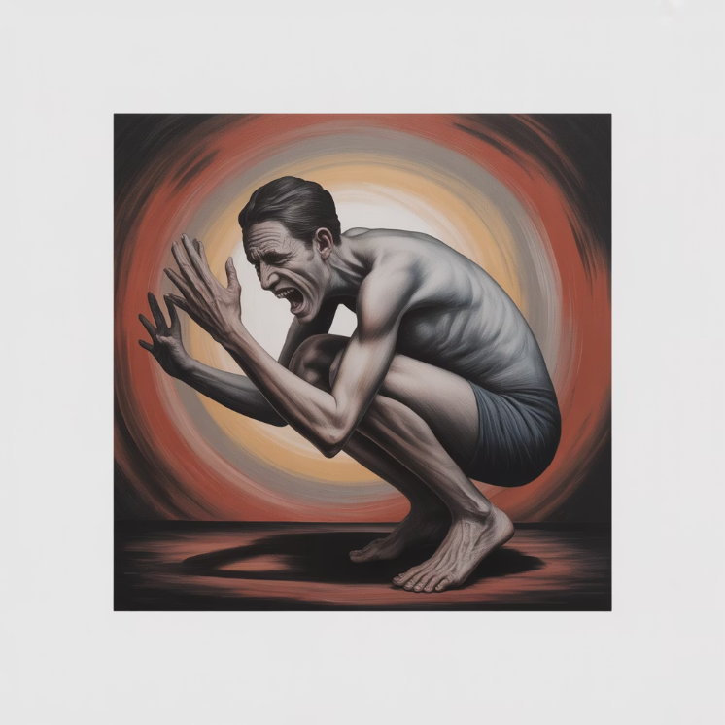
Behavioral Regression Patterns
People revert to instinctive habits
Communication becomes clipped
Listening decreases
Emotional tone hardens
Increased reliance on heuristics and stereotypes
Reduced empathy for others' perspectives
Tendency to externalize blame
Notes:
People revert to learned habits Communication becomes shorter, sharper Listening skill decreases noticeably Emotion replaces perspective easily Blame-seeking increases under stress
Example: Employee becomes abrupt during conflict. Cyber example: Team blames systems instead of root cause.

Slide 26
Time Compression Effects - Decision Quality
Time Compression Effects - Cognitive
Speed over accuracy
Loss of nuance
Impulse decision-making
Reduced empathy
Verbal intensity
Premature conclusions
Restless posture
Abrupt escalation
Risk misread
Judgment collapse
Notes:
Speed prioritized over accuracy often Impulsive actions increase significantly Nuance disappears during pressure Empathy declines under urgency Premature conclusions become common
Example: Team rushes without full info. Cyber example: Analyst flags false incident.

Slide 27

Impact on Leaders
Leaders feel visibility pressure
Confidence becomes harder to project
Emotional leakage is amplified
Tone becomes signal, not words
Reduced capacity for nuanced problem-solving
Increased reliance on intuition over data
Diminished patience for dissent or complex discussions
Notes:
Visibility pressure increases stress load Confidence becomes harder to project Emotions leak unintentionally Tone signals competence instantly Patience for complexity decreases
Example: Leader appears tense when questioned. Cyber example: CISO snaps under repeated updates.

Slide 28

Impact on Teams
Teams look for emotional anchoring
Silence is interpreted as loss of control
Fear accelerates rumor spread
People rely on leader posture
Uncertainty amplifies anxiety and reduces productivity
Lack of transparent communication breeds distrust
A leader's calm demeanor fosters a sense of security and stability
Notes:
Teams seek emotional stability quickly Silence interpreted as lost control Rumors spread rapidly under fear Leader posture shapes team behavior Anxiety reduces productivity significantly
Example: Team panics when leader withdraws. Cyber example: SOC miscoordinates during silent leadership.

Slide 29

Emotional Contagion
Nervous leaders spread nervousness
Calm leaders spread stability
Emotion transfers faster than logic
Tone reaches people before message
Non-verbal cues (facial expressions, body language) are potent carriers of emotion.
The unconscious mimicking of others' expressions and postures contributes to emotional transfer.
Collective emotional states can quickly form, influencing team performance and morale.
Notes:
Emotions spread faster than logic Nonverbal cues influence team mood Leader tone sets emotional baseline Contagion accelerates under uncertainty Group mindset shifts collectively
Example: Nervous boss spreads tension quickly. Cyber example: SOC becomes anxious after leader stress.

Slide 30
Combined Impact - Individual
Combined Impact - Organizational
Lower reasoning capacity
Spike in emotional load
Greater misreads
Higher error likelihood
Unstable attention
Shorter tolerance window
Threat exaggeration
Impulsive behavior
Trust fluctuation
Reduced resilience
Notes:
Individuals misread signals frequently Emotional load increases error likelihood Organizational focus becomes unstable Threats appear larger organizationally Resilience drops across entire system
Example: Team overreacts to minor issue. Cyber example: Organization assumes widespread compromise.

Slide 31

Stabilization Through Leadership Presence
First task is restoring psychological footing
Presence > messaging
Emotional containment precedes guidance
Calm resets reasoning
Leader's composure fosters psychological safety
Empathy and validation reduce emotional reactivity
Consistent reassurance builds collective confidence
Notes:
Presence calms heightened emotional states Containment precedes operational direction Empathy lowers defensive reactions Consistency builds renewed confidence Calm reopens reasoning pathways
Example: Leader’s calm voice settles room. Cyber example: CISO’s steady updates center SOC.

Slide 32

Early Psychological Countermeasures
Slow the tempo
Reduce ambiguity
Shorten communication loops
Anchor attention to now
Use direct, simple language
Prioritize immediate, actionable steps
Reiterate purpose and shared goals
Notes:
Slow down communication tempo Reduce ambiguity immediately Shorten feedback cycles consistently Anchor attention to present moment Use simple language under stress
Example: Manager simplifies tasks during confusion. Cyber example: Incident lead shortens update loops.

Slide 33

Summary & Takeaways
Crisis psychology reshapes how people think and behave
Stress shrinks cognitive range
Uncertainty amplifies perceived threat
Time compression distorts urgency
Emotional contagion spreads faster than logic
Stability must be restored before direction
Leadership is psychological before operational
Acknowledging fear validates experience, reducing isolation
Empowering action combats helplessness and restores agency
Structured hope provides a path forward beyond immediate crisis
Notes:
Crisis shrinks cognitive capacity quickly Uncertainty amplifies perceived risk Time compression distorts urgency perception Emotional contagion spreads instability fast Stability must precede effective direction
Example: Team steadies after leader sets clarity. Cyber example: SOC stabilizes after simplified guidance.

Slide 34
BREAK TIME
Be back in 15 mins.
Notes:
https://www.ncsc.gov.uk/static-assets/documents/PwnedPasswordsTop100k.txt

Slide 35

Traits of Effective Crisis Leaders
Clarity, Calmness, Decisiveness, and Adaptability in high-pressure conditions
The Role of Traits in Crisis Leadership
Capabilities matter less if leadership posture collapses, undermining trust and efficacy.
Traits shape how people interpret leader actions, influencing team morale and response.
Behavior becomes the message during crisis, fostering confidence or anxiety.
These traits determine psychological safety, crucial for open communication and problem-solving.
Notes:
Traits shape team’s emotional perception Behavior signals competence instantly Psychological safety precedes performance outcomes Authenticity deepens staff trust significantly Consistency anchors organizational confidence
Example: Team trusts leader due to reliable tone. Cyber example: CISO’s calm regularity reassures analysts.

Slide 36
CLASS AGENDA
CLASS OBJECTIVES
Why traits drive response outcomes
Clarity under uncertainty
Calmness under stress
Decisiveness under time compression
Adaptability in changing conditions
Recognize trait-based leadership effects
See how traits reduce chaos
Understand stabilizing posture signals
Link traits to psychological influence
Prepare for real crisis behaviors

Slide 37
Why Traits Matter More Than Plans
People follow emotional tone, even before clear direction.
Traits firmly anchor their perception of effective control.
Psychological safety always precedes successful and rapid execution.
Competence is truly judged through behavior during crisis.
Leaders' authenticity builds crucial trust and commitment.
Consistency in values ensures organizational stability.

Slide 38

Clarity
Reduces mental fog, enhances clear decision-making
Shortens uncertainty loops, fostering swift action
Converts complexity into direction, simplifying intricate problems
Helps others reorient under pressure, guiding effective responses
Promotes transparent communication within the team
Builds trust and confidence among stakeholders
Notes:
Reduces confusion during peak stress Simplifies choices when overloaded Converts uncertainty into actionable steps Keeps teams aligned quickly Strengthens trust through direct communication
Example: Leader outlines three clear priorities. Cyber example: CISO specifies exact containment steps.

Slide 39
CLARITY REFLECTION
Communication Elements
Delivery Style
Simple statements
Direct framing
Defined next steps
No hedging language
No excess detail
Visible priorities
Pacing controlled
Fewer choices
Signal over noise
Confidence in delivery
Notes:
Use simple, specific messaging always Provide defined next actionable steps Remove unnecessary background information Set visible priorities for alignment Maintain confident, concise delivery
Example: Manager gives short, clear update. Cyber example: Incident lead outlines exact sequence.

Slide 40

Calmness
Emotional containment becomes stability, fostering inner peace.
Tone regulates group physiology, promoting collective composure.
Presence lowers panic threshold, creating a safe space.
Calm signals control before instruction, building trust effectively.
Clear thinking emerges from settled minds.
Reduces reactivity, enhances thoughtful responses.
Notes:
Emotional containment stabilizes group mood Calm tone lowers stress reactivity Presence signals controlled leadership Clear thinking emerges from calm Calm spreads through entire team
Example: Staff relax after leader’s steady tone. Cyber example: Analyst steadies after calm briefing.

Slide 41
CALMNESS REFLECTION
Physical Presence
Emotional Regulation
Measured voice
No panic cues
Steady tempo
Neutral language
Lower volume
Slowing urgency
Grounded posture
Emotional consistency
Predictable cadence
Non-reactive stance
Notes:
Use measured voice consistently Maintain slow, predictable tempo Adopt grounded physical posture Avoid emotionally loaded language Show nonreactive emotional stance
Example: Leader speaks softly during tension. Cyber example: CISO reduces urgency in updates.

Slide 42

Decisiveness
Prevents uncertainty from spiraling, ensuring clear path ahead.
Protects momentum, driving projects continually forward.
Demonstrates ownership, fostering strong accountability always.
Keeps response directional, guiding decisions effectively onward.
Instills confidence within the entire team.
Minimizes wasted time and valuable resources.
Notes:
Prevents uncertainty from expanding Protects operational momentum immediately Demonstrates ownership under pressure Clarifies direction without hesitation Boosts team’s confidence quickly
Example: Leader chooses path quickly when unclear. Cyber example: CISO approves immediate system isolation.

Slide 43
DECISIVENESS REFLECTION
Decision Process
Authority Display
Fast activation ensures quick initial response
Visible authority builds immediate trust quickly
No ambiguity clarifies intent immediately
Confident framing establishes clear direction strongly
Defined outcomes guide every decision swiftly
No waiting posture indicates readiness always
Short commands boost team responsiveness greatly
Minimal debate streamlines all decision-making
Closed decisions prevent any second-guessing
Momentum maintained drives continuous progress forward
Proactive engagement reduces potential delays.
Clear communication drives efficient execution.
Decisive actions inspire team confidence.
Strong leadership ensures consistent progress.
Notes:
Act quickly with defined outcomes Avoid ambiguous decision language Provide short, directional commands Close decisions to avoid drift Use authority visibly to guide
Example: Manager ends debate with firm choice. Cyber example: Incident lead finalizes containment.

Slide 44
Adaptability
Crisis conditions can evolve rapidly with absolutely no prior warning.
Leaders must shift their posture strategically without losing vital stability.
Adaptability consistently maintains leadership credibility, even during challenges.
Flexibility prevents escalation effectively from freezing important organizational progress.
Embracing change allows organizations to navigate unforeseen obstacles successfully.
Proactive adjustments minimize potential risks and foster sustained growth.
Notes:
Adjust posture without losing stability Respond fluidly to changing conditions Maintain credibility during shifts Prevent rigidity from worsening chaos Adaptation sustains effective leadership
Example: Leader changes plan calmly when needed. Cyber example: CISO updates strategy mid-incident.

Slide 45
SUMMARY & TAKEAWAYS
Traits determine perceived leadership strength in times of crisis.
Clarity reduces uncertainty and fosters confident decision-making.
Calmness prevents escalation and maintains rational thought.
Decisiveness restores direction and inspires renewed progress.
Adaptability sustains momentum through evolving complex challenges.
Behavior shapes trust more than messaging during challenging unpredictable situations.
These traits are stabilization tools, not personality preferences for effective leadership.
Empathy builds connection and understanding during difficult times.
Resilience enables recovery and continued forward movement.
Notes:
Traits shape perceived leader strength Clarity reduces team confusion Calm preserves psychological safety Decisiveness keeps actions moving Adaptability maintains control throughout crisis
Example: Staff follow leader showing consistent traits. Cyber example: SOC trusts steady, decisive CISO.

Slide 46
BREAK TIME
Be back in 15 mins.
Notes:
https://www.ncsc.gov.uk/static-assets/documents/PwnedPasswordsTop100k.txt

Slide 47
Lab Time
1 Hour
Notes:
https://www.ncsc.gov.uk/static-assets/documents/PwnedPasswordsTop100k.txt

Slide 48


Crisis Leadership: Recap & Review
Psychology, Traits, and Stabilization Through Presence
Crisis Leadership Overview
Crisis shifts leadership from optimization to stabilization
Presence and posture become signals of control
Clarity matters more than technical precision
Calm is interpreted as capability
The leader becomes the emotional "anchor" under stress
Governance Anchor: "Crisis leadership protects psychological stability so governance can operate effectively."
Notes:
Presence stabilizes emotional environment Clarity matters more than precision Calm interpreted as capability signal Authority becomes psychological anchor Stabilization precedes effective strategy
Example: Staff calm after leader speaks steadily. Cyber example: CISO’s tone resets SOC urgency.

Slide 49

Psychology of Crisis
Crisis pushes people into survival mode
Emotion comes before logic when threat is perceived
Stress and uncertainty shrink cognitive range
Time compression increases reactive decisions
Stabilization of the mind comes before stabilization of the system
Governance Anchor: "Before strategy works, the mind must be stabilized."
Notes:
Threat triggers survival thinking patterns Stress reduces decision quality Uncertainty magnifies perceived risk Time compression distorts urgency Emotional contagion spreads rapidly
Example: Team panics without clear updates. Cyber example: Analysts rush decisions under stress.

Slide 50
Traits of Effective Crisis Leaders
Clarity reduces overwhelm and creates direction
Calm preserves psychological safety
Decisiveness prevents drift and hesitation
Adaptability sustains control as conditions evolve
Traits are leadership tools, not personality preferences
Governance Anchor: "Traits hold confidence in place when plans have not yet taken hold."
Notes:
Clarity reduces overwhelm quickly Calm regulates team’s emotional state Decisiveness prevents organizational drift Adaptability sustains control changes Traits anchor collective confidence
Example: Staff follow leader showing stable traits. Cyber example: SOC trusts decisive containment steps.

Slide 51

Crisis Leadership Behaviors in Practice
Posture and tone shape collective emotion
Communication must be direct and stabilizing
Authority must be visible and firm
Emotional containment precedes guidance
Presence is interpreted as competence
Governance Anchor: "Leadership becomes operational when emotional stability is restored."
Notes:
Posture influences team emotional stability Direct messaging reduces confusion Visible authority reassures quickly Emotional containment precedes guidance Presence demonstrates operational competence
Example: Manager stands confidently during update. Cyber example: CISO’s steady tone calms analysts.

Slide 52
Lab Application: Decision-Making Under Pressure
The lab simulates time-compressed decision cycles
Stress testing posture precedes testing plans
Leaders must stabilize tone before directing action
Execution confidence is a leadership output
Behavior under pressure becomes evidence of maturity
Governance Anchor: "Crisis leadership is proven through live posture, not documentation."
Notes:
Simulates compressed decision timelines Tests leadership posture under stress Reveals emotional leakage patterns Strengthens rapid stabilization skills Demonstrates maturity through behavior
Example: Leader decides quickly during simulation. Cyber example: CISO directs immediate containment confidently.

Slide 53
Kahootz & Quiz Time
Notes:
https://www.ncsc.gov.uk/static-assets/documents/PwnedPasswordsTop100k.txt

